Slide 1

Shri RamSwaroop Memorial University
Institute Of Technology
Department of computer science & Information Systems
Name: Amit Dubey
Dr. Bineet Kumar Gupta
Roll.no-20221010101050076
(Head of the Department)

Slide 2
internship services
Project Tag-Line: Easy To Choose
Easy Give

Slide 3
internship services
Introduction
Objective
Technology
Purpose
Requirement Of Software & Hardware
Features
Screenshot
Conclusion
Presenting By Amit Dubey

Slide 4
INTERNSHIP SERVICES
Introduction
This project is a web Application to provide online course for Students. The project objective is to provide the for the students search Internship Services.Internship is supervised ,structured learning experiences in a professional setting that allow you to gain valuable work experiance in a student choosen field of study.
Presenting By Amit Dubey

Slide 5
Internship Services
Objective
➢Branch Details.
➢Semester Wise Module Details.
➢Student Personal Details.
➢Student Previous Qualification details.
➢Company details
➢Staff Leave Details.
Presenting By Amit Dubey

Slide 6
Internship services
Technology
Project built on Python.
Frontend designing using Html CSS bootsratp_5 & JavaScript .
Database using Mysql.
Presenting By Amit Dubey

Slide 7
Internship Services
Technology&Use
Visual studio code
Browser: Chrome etc.
Python Language
Html, CSS & javascript
Presenting By Amit Dubey

Slide 8
Inetrnship Services
Purpose
Efficient Multi User System.
Graphical User Interface having good aesthetics and facilitating easy operation.
Online Help.
Security features based on user privileges to prevent invalid access.
Efficient Mobile and Web Interface.
Presenting By Amit Dubey

Slide 9
internship services
Software & Hardware Requirement
Web-browser: Google Chrome etc.
Operating system: windows
Python,html,css,javascript,Mysql.
Presenting By Amit Dubey

Slide 10
Internship Services
Hardware Requirement
Ram:4 Gb above
Processor: core i3
Rom:1tb
Presenting By Amit Dubey

Slide 11
internship services
Scope
Students can apply leave 24*7 request and accepting facility. If Studentsnin facing any problem then easily leave provides HOD.
Presenting By Amit Dubey

Slide 12
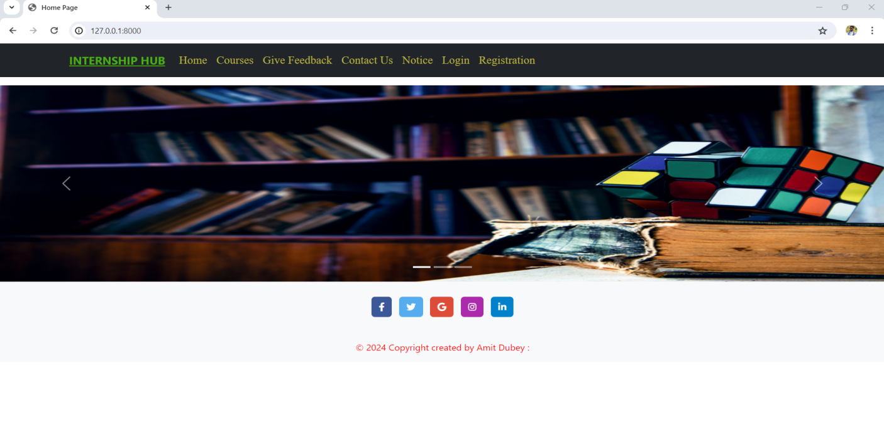
screen shot

Slide 13
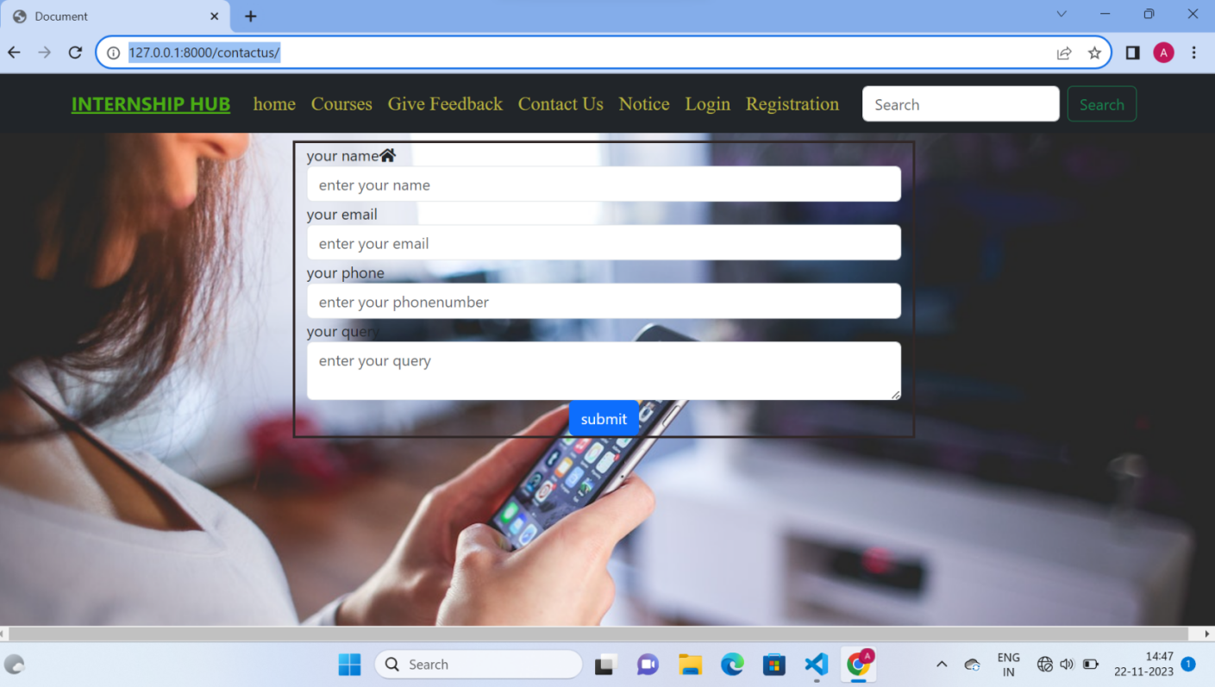
screen shot

Slide 14
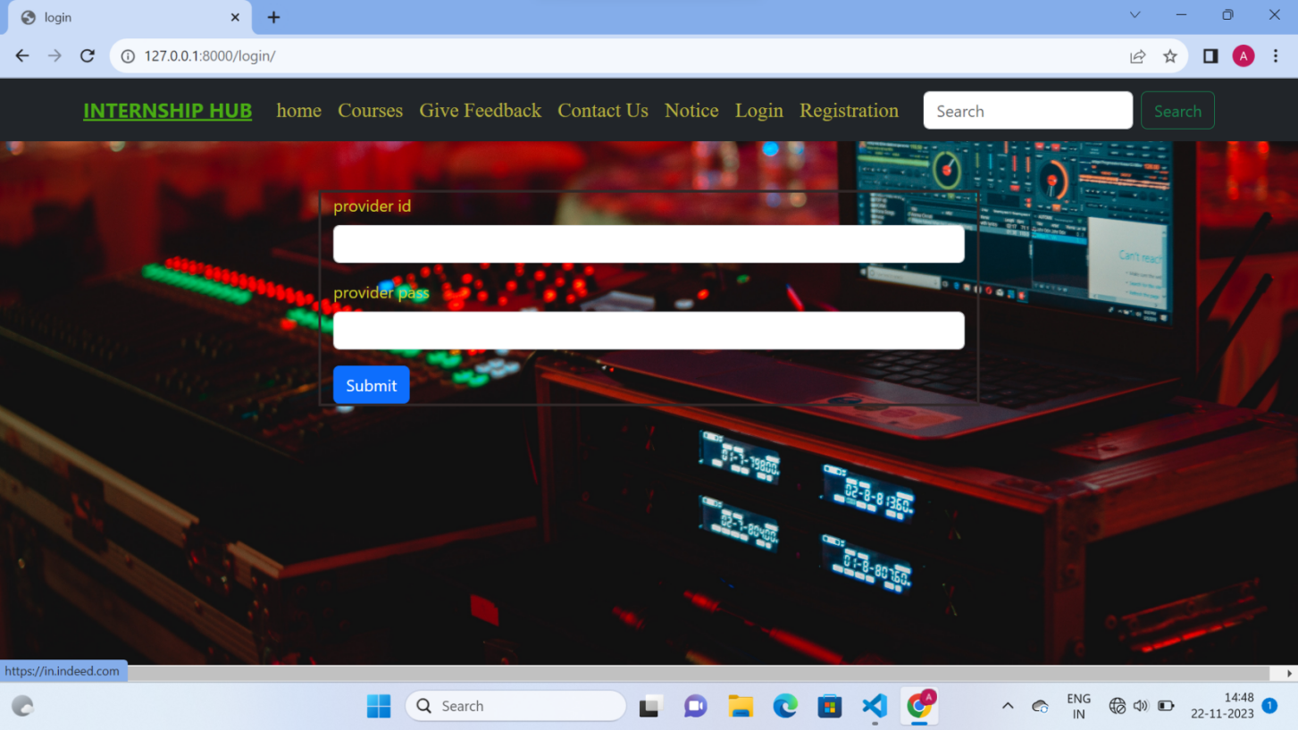
screen shot

Slide 15
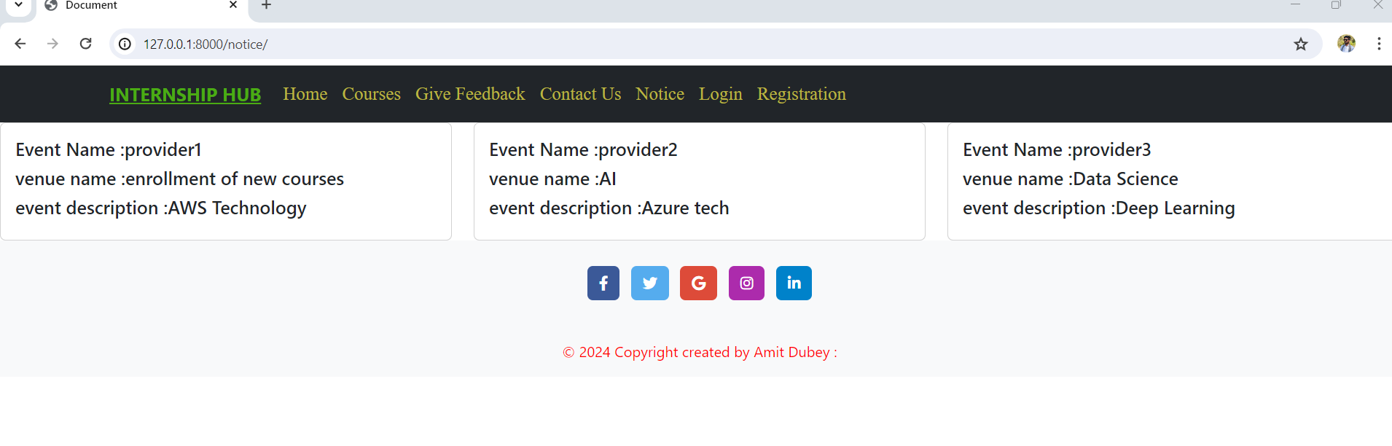
screen shot

Slide 16
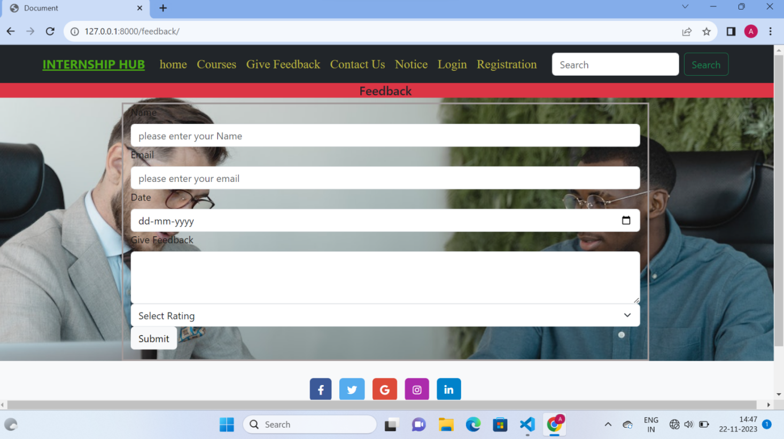

Slide 17
Thank You

